Slide 1
HISTORY OF PHARMACY
PREPARED BY
Dr.SREEJA.S
H.o.D, Dept. of Pharmacy

Slide 2
HOMOEOPATHIC PHARMACY is defined as the art and science of identifying, collecting, preparing, preserving, evaluating, standardising and dispensing of medicines. It also deals with the legal and professional aspects and regulation of proper distribution of medicines
The word pharmacy is derived from the Greek term PHARMAKON which means drug, remedy, poison, magic spell

Slide 3
Dawn of Humanity
Since the dawn of humanity, diseases have claimed the attention of man.
This urged him to look out for the solution of his problems – food, disease and death.
When injured, he applied a leaf, cool water or mud to stop the bleeding. He learned that certain leaves served him better than others.
Prehistoric people gathered plants for medicinal purpose. The wise man of the tribe gathered knowledge of the healing properties through experience.

Slide 4
A Dual Heritage
Disease was considered a punishment by the offended God. Accordingly, magic was employed as a remedial agent and priests became in charge of religion and medicine.
When organized settlements arose, changes influenced concepts of disease and healing. Man learned how to control nature andthe powers of Gods started declining.

Slide 5
The magical healer relied more on spells and used magical stones more than plant materials.
The empirical healer relied upon drugs. The physicians and other healers took on the duties of medicine preparation.

Slide 6
Era of Hippocrates and Galen
Hippocrates : Given a rational explanation for illness
Conceived a link
between environment
and humanity –
connected four elements of universe - earth, air, fire and water to four humors of body
- black bile, blood,
yellow bile, phlegm.

Slide 7
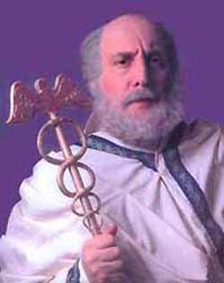
HIPPOCRATES

Slide 8
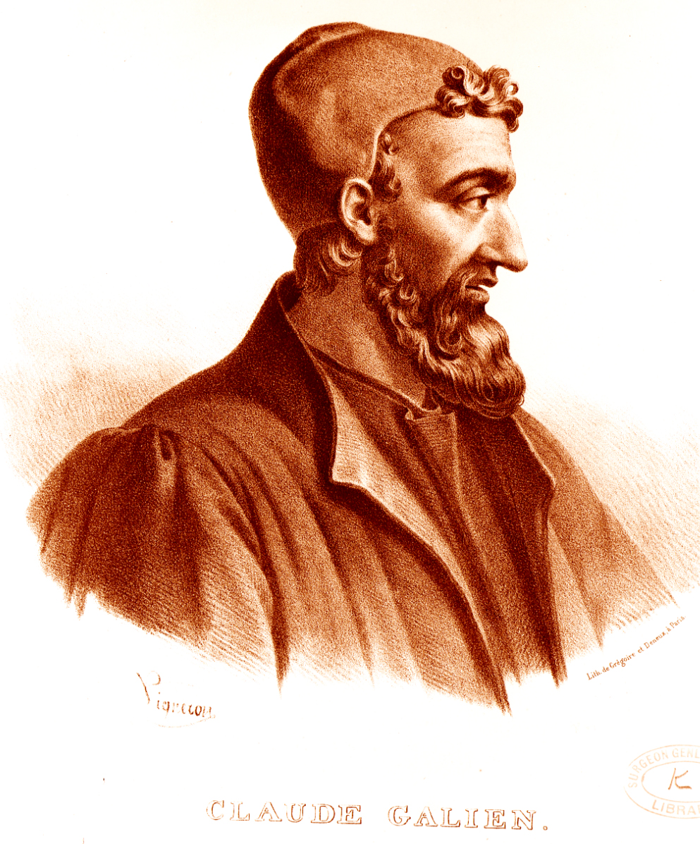
GALEN

Slide 9
Galen - 2nd century AD :
Galen devised a system to balance
the humors by using drugs of a
contrary nature.
Galen also advocated polypharmacy.
Galen had an ‘iatreion’ where he
received patients; he also had an ‘apotheca’ or store and preparation room.

Slide 10
THE CHANGING TIMES
New drugs were arriving from far-off lands, unknown to the ancients.
For pharmacy, printing had a profound effect on the study of plant drugs, because illustrations of the plant drugs could be reproduced easily.

Slide 11
Among the most gifted of these
investigators was Valerius Cordus
(1515 - 1544) whose Dispensatorium
became the official standard for the
preparation of medicines in the city
of Nuremberg and generally is
considered the first pharmacopoeia

Slide 12
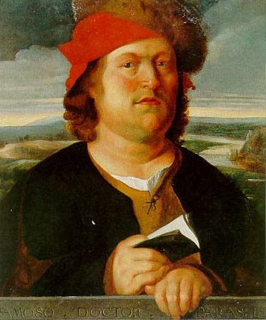
PARACELSUS

Slide 13
DOCTRINE OF SIGNATURE
Paracelsus - advocated chemically prepared drugs from crude plant and mineral substances.
He preached the ‘Doctrine of signature’,
a belief that God had placed a sign on healing
substances indicating their use against disease
The relation between the external morphological appearance of the drug and signs and symptoms of the natural disease is called DOCTRINE OF SIGNATURE

Slide 14
He sparked the growth of modern
pharmaceutical sciences. Eventually,
as the efficacy of some of these drugs
became known, they entered
professional medical practice and
appeared in books on medicines.
Here was a great leap in pharmacy :
the preparation of medicines.

Slide 15

EUPHRASIA OFFICINALIS

Slide 16

GELSEMIUM SEMPERVIRENS

Slide 17

TARENTULA HISPANICA

Slide 18

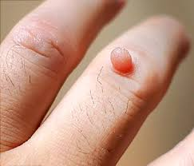
THUJA OCCIDENTALIS

Slide 19

PULSATILLA NIGRICANS

Slide 20
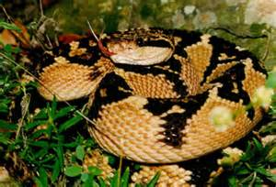
LACHESIS MUTANS

Slide 21
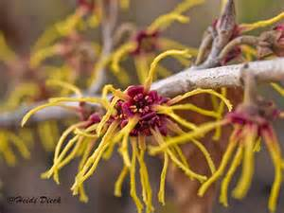
HAMAMELIS VIRGINIA

Slide 22
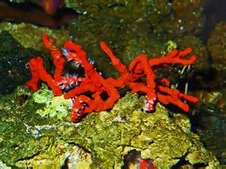
CORALLIUM RUBRUM

Slide 23
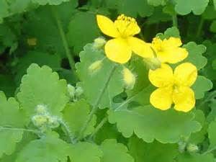
CHELIDONIUM MAJUS

Slide 24
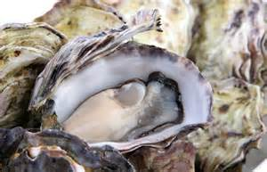

CALCAREA CARBONICUM

Slide 25
Developments in Pharmacy
Pharmacy was now being explored in laboratories.
The legal and scientific foundations of pharmacy were also established along with organizations - led to standardization and publication of pharmacopoeias.

Slide 26
PHARMACOPOEIA
It is the supreme authoritative book, published by an authority, government of any country that deals with the rules and regulations of standardizations of drug substances. It contains directions for collection of drug substances from different sources, their preparation, preservation and standards that determine their strength and purity.

Slide 27
A more modern viewpoint also emerged, to isolate pure, crystalline chemical constituents that could be measured accurately and identified chemically.
To search, separate, characterize and identify the sources of chemicals contained in the simplest plant drug was a challenge as great as any exploration.

Slide 28
Specifics in Medicine
Man was either taken as a machine or a laboratory test tube. The whole living man was entirely ignored.
17th century -
Thomas Sydenham impressed upon medical
profession the necessity of discovering specifics for diseases.

Slide 29
Sydenham was eclipsed by
emergence of innumerable theorists
and speculators in the field of
medicine. Practically the whole of
Europe was marked by a plethora of
theories and hypotheses.

Slide 30
Lack of Principles
Innumerable and dissimilar ideas respecting the nature of diseases and their remedies sprang from so many dissimilar brains and the theoretical views these gave rise to the so-called systems, each of which was at variance with the rest and self-contradictory.

Slide 31
Hence, started the 'mixture‘
prescriptions, blood lettings and other
crude and torturous therapeutic
practices.
There was chaos with total absence of
any general or fixed principles or laws
of treatment.

Slide 32
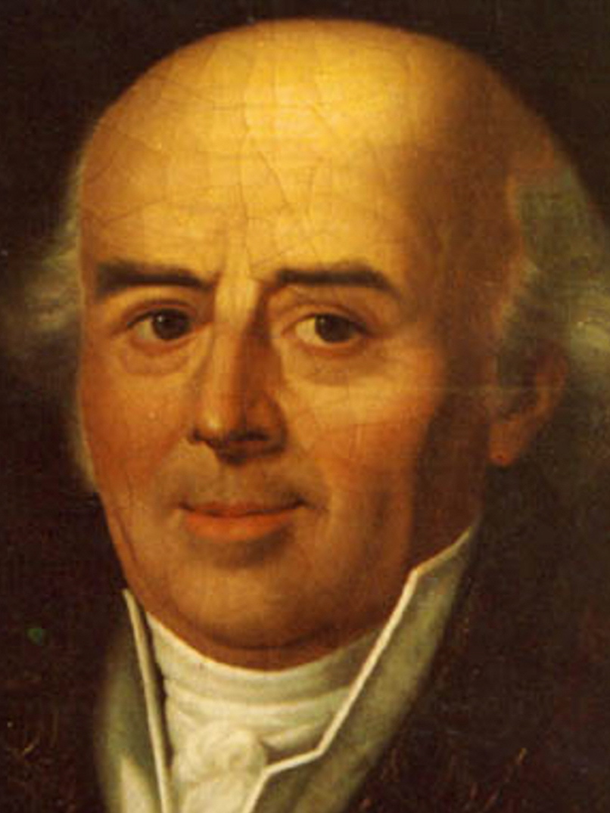
C.F.SAMUEL HAHNEMANN

Slide 33
Hahnemann challenged the practice of medicine and the apothecaries at his time. Hahnemann’s greatest contributions,
in relation to pharmacy are the …
Principle of Dynamization,
the use of the Single simple remedy
(monopharmacy) and Drug proving.

Slide 34
MEDICAL PHILOSOPHY DURING HAHNEMANN’S TIME
RATIONALISTS - One could not cure a disease, unless the cause was known. With the understanding of anatomy, physiology and pathology, the focus of the cause of disease was shifted to structures and functions of human body, rather than external world

Slide 35
EMPIRICISTS – Based on what takes its data from the reports of the senses and does not allow the reason to work on it, without following a method or a systematic plan of investigation.

Slide 36
METHODISTS - Observed some general symptoms of disease, started classifying disease and built up books of medicine. Can arrest the disease process by administration of drugs whose pharmacological action could antidote the symptom of disease.

Slide 37
MODES OF TREATMENT DURING HAHNEMANN’ TIME
TREATMENT BASED ON NAME OF THE DISEASE-
Mere name of a supposed disease was sufficient to determine the indication for the remedy. several medicines for each name of a disease was used. Blindly gave one medicine after the other until one hits upon the right one. But one can only go on with such experiments as long as the patience, the purse or the life of the patient lasts.

Slide 38
TREATMENT BASED ON THE SYMPTOM-
Using general remedies
Pains – sedatives
Weakness – tonics
Constipation – purgatives
Fever - antipyretics
Spasms - antispasmodics

Slide 39
TREATMENT OF THE CAUSE:
Diseases due to material cause -
Removal of the material cures the condition
Disease due to immaterial dynamic cause - May be acute, sub acute or a chronic nature. Need dynamic medicines to cure.
NEEDS THE TRUE HEALING ART - HOMOEOPATHY

Slide 40
Though modern techniques, developments,
research, new ideas and sophistication
identify the pharmaceutical practice of the
‘Modern Medicine’, the principles on which
the practice of modern medicine
is based is still, to this date,
materialistic and cannot be termed as
TRUE HEALING ART.

